Slide 1
Unit 3
IMAGE ENHANCEMENT: FILTERING IN THE FREQUENCY DOMAIN
Image Enhancement in Frequency Domain

Slide 2
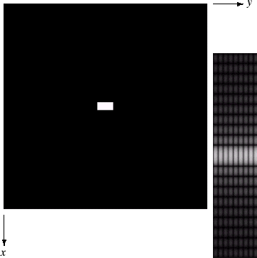
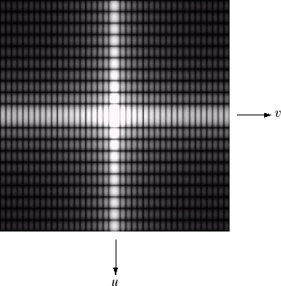

DFT & Images
The DFT of a two dimensional image can be visualised by showing the spectrum of the images component frequencies
Images taken from Gonzalez & Woods, Digital Image Processing (2002)
DFT

Slide 3
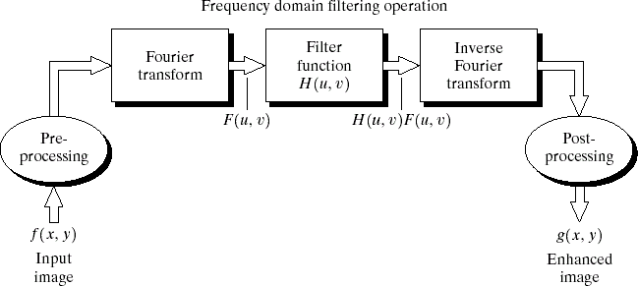
The DFT and Image Processing
To filter an image in the frequency domain:
Compute F(u,v) the DFT of the image
Multiply F(u,v) by a filter function H(u,v)
Compute the inverse DFT of the result
Images taken from Gonzalez & Woods, Digital Image Processing (2002)

Slide 4
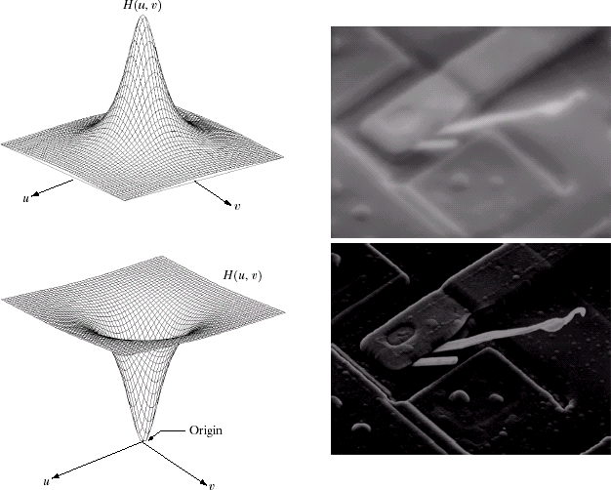
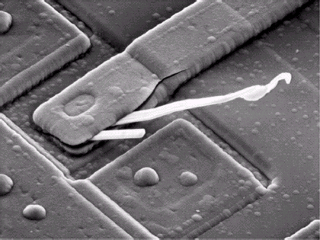
Some Basic Frequency Domain Filters
Low Pass Filter
Images taken from Gonzalez & Woods, Digital Image Processing (2002)
High Pass Filter

Slide 5
Smoothing Frequency Domain Filters
Smoothing is achieved in the frequency domain by dropping out the high frequency components
The basic model for filtering is:
G(u,v) = H(u,v)F(u,v)
where F(u,v) is the Fourier transform of the image being filtered and H(u,v) is the filter transform function
Low pass filters – only pass the low frequencies, drop the high ones
Smoothing (blurring) is achieved in the frequency domain by high frequency attenuation; that is by low pass filtering

Slide 6
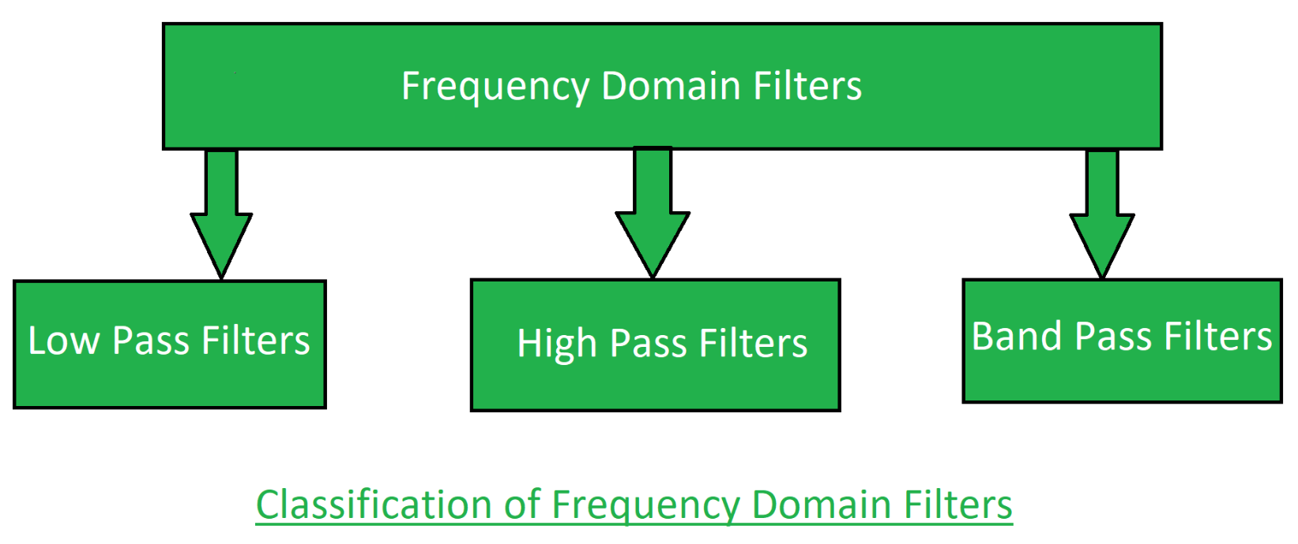
Frequency Domain Filters and its Types

Slide 7
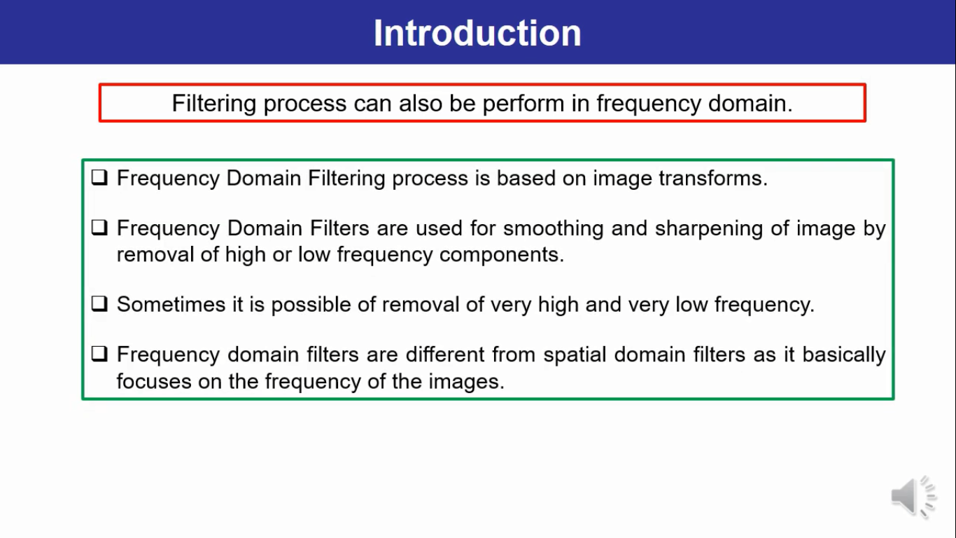
Frequency domain filtering is preferred over spatial domain because it involves less computations

Slide 8
Low pass filter:
Low pass filter removes the high frequency components that means it keeps low frequency components. It is used for smoothing the image.
It is used to smoothen the image by attenuating high frequency components and preserving low frequency components.
Mechanism of low pass filtering in frequency domain is given by:
G(u, v) = H(u, v) . F(u, v) where F(u, v) is the Fourier Transform of original image and H(u, v) is the Fourier Transform of filtering mask

Slide 9
2. High pass filter:
High pass filter removes the low frequency components that means it keeps high frequency components. It is used for sharpening the image. It is used to sharpen the image by attenuating low frequency components and preserving high frequency components.
Mechanism of high pass filtering in frequency domain is given by:
H(u, v) = 1 - H'(u, v) where H(u, v) is the Fourier Transform of high pass filtering and H'(u, v) is the Fourier Transform of low pass filtering
3. Band pass filter:
Band pass filter removes the very low frequency and very high frequency components that means it keeps the moderate range band of frequencies. Band pass filtering is used to enhance edges while reducing the noise at the same time.

Slide 10
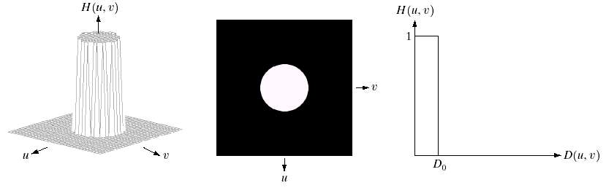
Ideal Low Pass Filter
Simply cut off all high frequency components that are a specified distance D₀ from the origin of the transform
Images taken from Gonzalez & Woods, Digital Image Processing (2002)
changing the distance changes the behaviour of the
filter

Slide 11
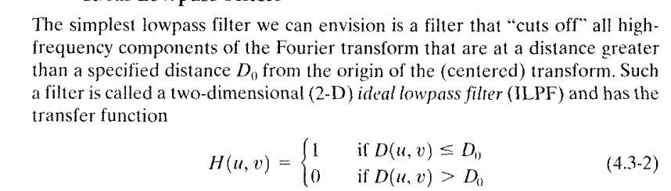
Ideal Low Pass Filter (cont…)
Where D0 is the positive quantity

Slide 12
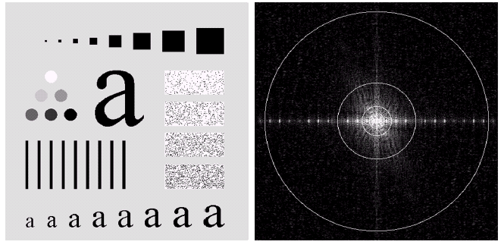
Ideal Low Pass Filter (cont…)
Images taken from Gonzalez & Woods, Digital Image Processing (2002)
Above we show an image, it’s Fourier spectrum and a series of ideal low pass filters of radius 5, 15, 30, 80 and 230 superimposed on top of it

Slide 13
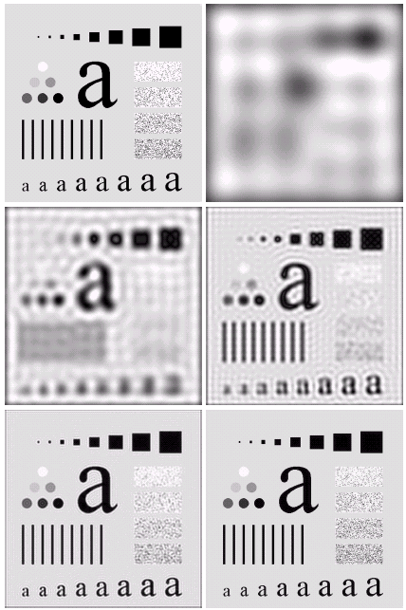
Ideal Low Pass Filter (cont…)
Result of filtering with ideal low pass filter of radius 5
Original image
Result of filtering with ideal low pass filter of radius 15
Result of filtering with ideal low pass filter of radius 30
Images taken from Gonzalez & Woods, Digital Image Processing (2002)
Result of filtering with ideal low pass filter of radius 80
Result of filtering with ideal low pass filter of radius 230
The “ringing” effect can be seen, which becomes finer in texture as the amount of high frequency content removed decreases.

Slide 14
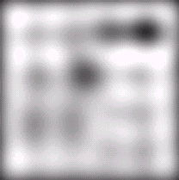
Ideal Low Pass Filter (cont…)
Result of filtering with ideal low pass filter of radius 5
Images taken from Gonzalez & Woods, Digital Image Processing (2002)

Slide 15
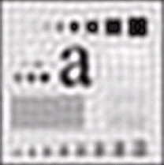
Ideal Low Pass Filter (cont…)
Result of filtering with ideal low pass filter of radius 15
Images taken from Gonzalez & Woods, Digital Image Processing (2002)

Slide 16
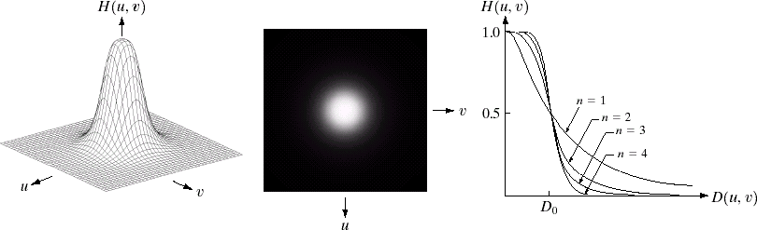
Butterworth Lowpass Filters
The transfer function of a Butterworth lowpass filter of order n with cutoff frequency at distance D₀ from the origin is defined as:
1
H (u, v) =
1+[D(u, v) / D ]^{2 n}
0
Images taken from Gonzalez & Woods, Digital Image Processing (2002)
Unlike the ILPF, the BLPF transfer function does not have a sharp discontinuities that gives a clear cut off between passed and filtered frequencies.

Slide 17
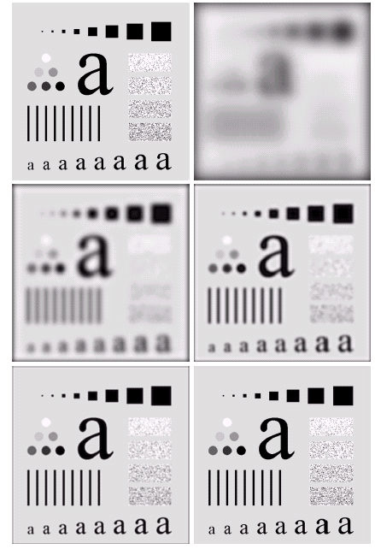
Butterworth Lowpass Filter (cont…)
Result of filtering with Butterworth filter of order 2 and cutoff radius 5
Original image
Result of filtering with Butterworth filter of order 2 and cutoff
radius 15
Result of filtering with Butterworth filter of order 2 and cutoff radius 30
Images taken from Gonzalez & Woods, Digital Image Processing (2002)
Result of filtering with Butterworth filter of order 2 and cutoff
radius 80
Result of filtering with Butterworth filter of order 2 and cutoff radius 230
The BLPFof order 1 has no ringing effect. Order 2 does show mild ringing effect.

Slide 18
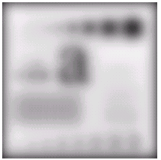
Butterworth Lowpass Filter (cont…)
Original image
Result of filtering with Butterworth filter of order 2 and cutoff radius 5
Images taken from Gonzalez & Woods, Digital Image Processing (2002)

Slide 19
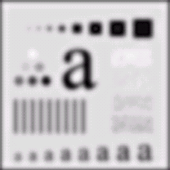
Butterworth Lowpass Filter (cont…)
Result of filtering with Butterworth filter of order 2 and cutoff
radius 15
Images taken from Gonzalez & Woods, Digital Image Processing (2002)

Slide 20
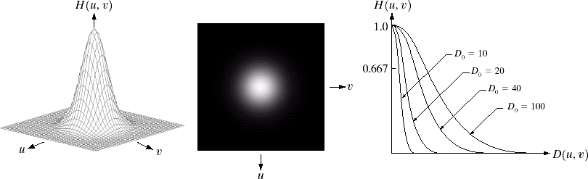
Gaussian Lowpass Filters
The transfer function of a Gaussian lowpass filter is defined as:
₂ 2
_{H (u, v) = e}−D (u,v)/ 2D₀
Images taken from Gonzalez & Woods, Digital Image Processing (2002)

Slide 21
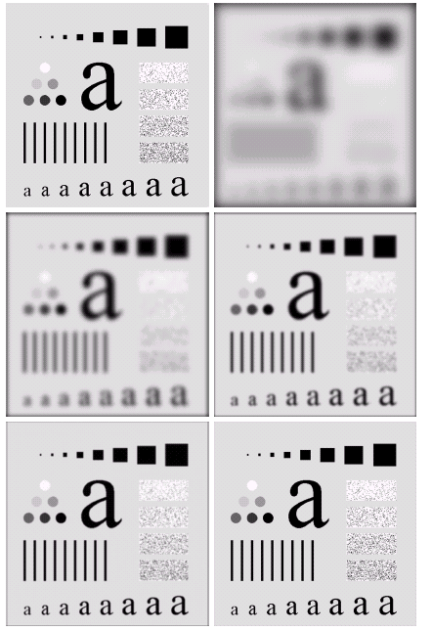
Gaussian Lowpass Filters (cont…)
Result of filtering with Gaussian filter with cutoff radius 5
Original image
Result of filtering with Gaussian filter with cutoff
radius 15
Result of filtering with Gaussian filter with cutoff radius 30
Images taken from Gonzalez & Woods, Digital Image Processing (2002)
Result of filtering with Gaussian filter with cutoff
radius 85
Result of filtering with Gaussian filter with cutoff radius 230

Slide 22
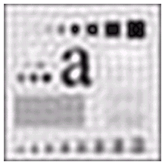
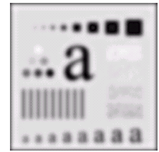
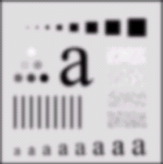
Lowpass Filters Compared
Result of filtering with ideal low pass filter of radius 15
Result of filtering with Butterworth filter of order 2 and cutoff radius 15
Images taken from Gonzalez & Woods, Digital Image Processing (2002)
Result of filtering with Gaussian filter with cutoff
radius 15

Slide 23
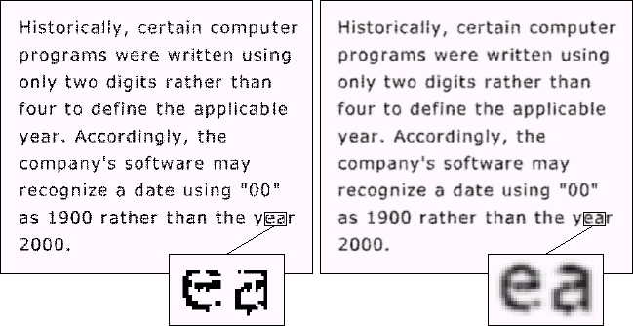
Lowpass Filtering Examples
A low pass Gaussian filter is used to connect broken text
Images taken from Gonzalez & Woods, Digital Image Processing (2002)

Slide 24
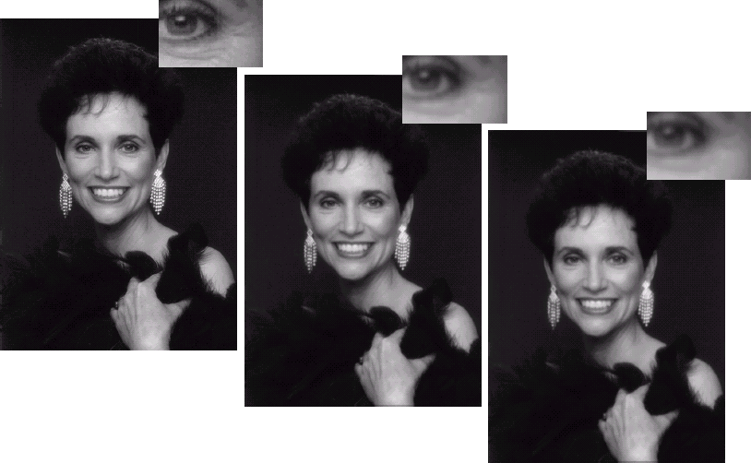
Lowpass Filtering Examples (cont…)
Different lowpass Gaussian filters used to remove blemishes in a photograph
Images taken from Gonzalez & Woods, Digital Image Processing (2002)

Slide 25
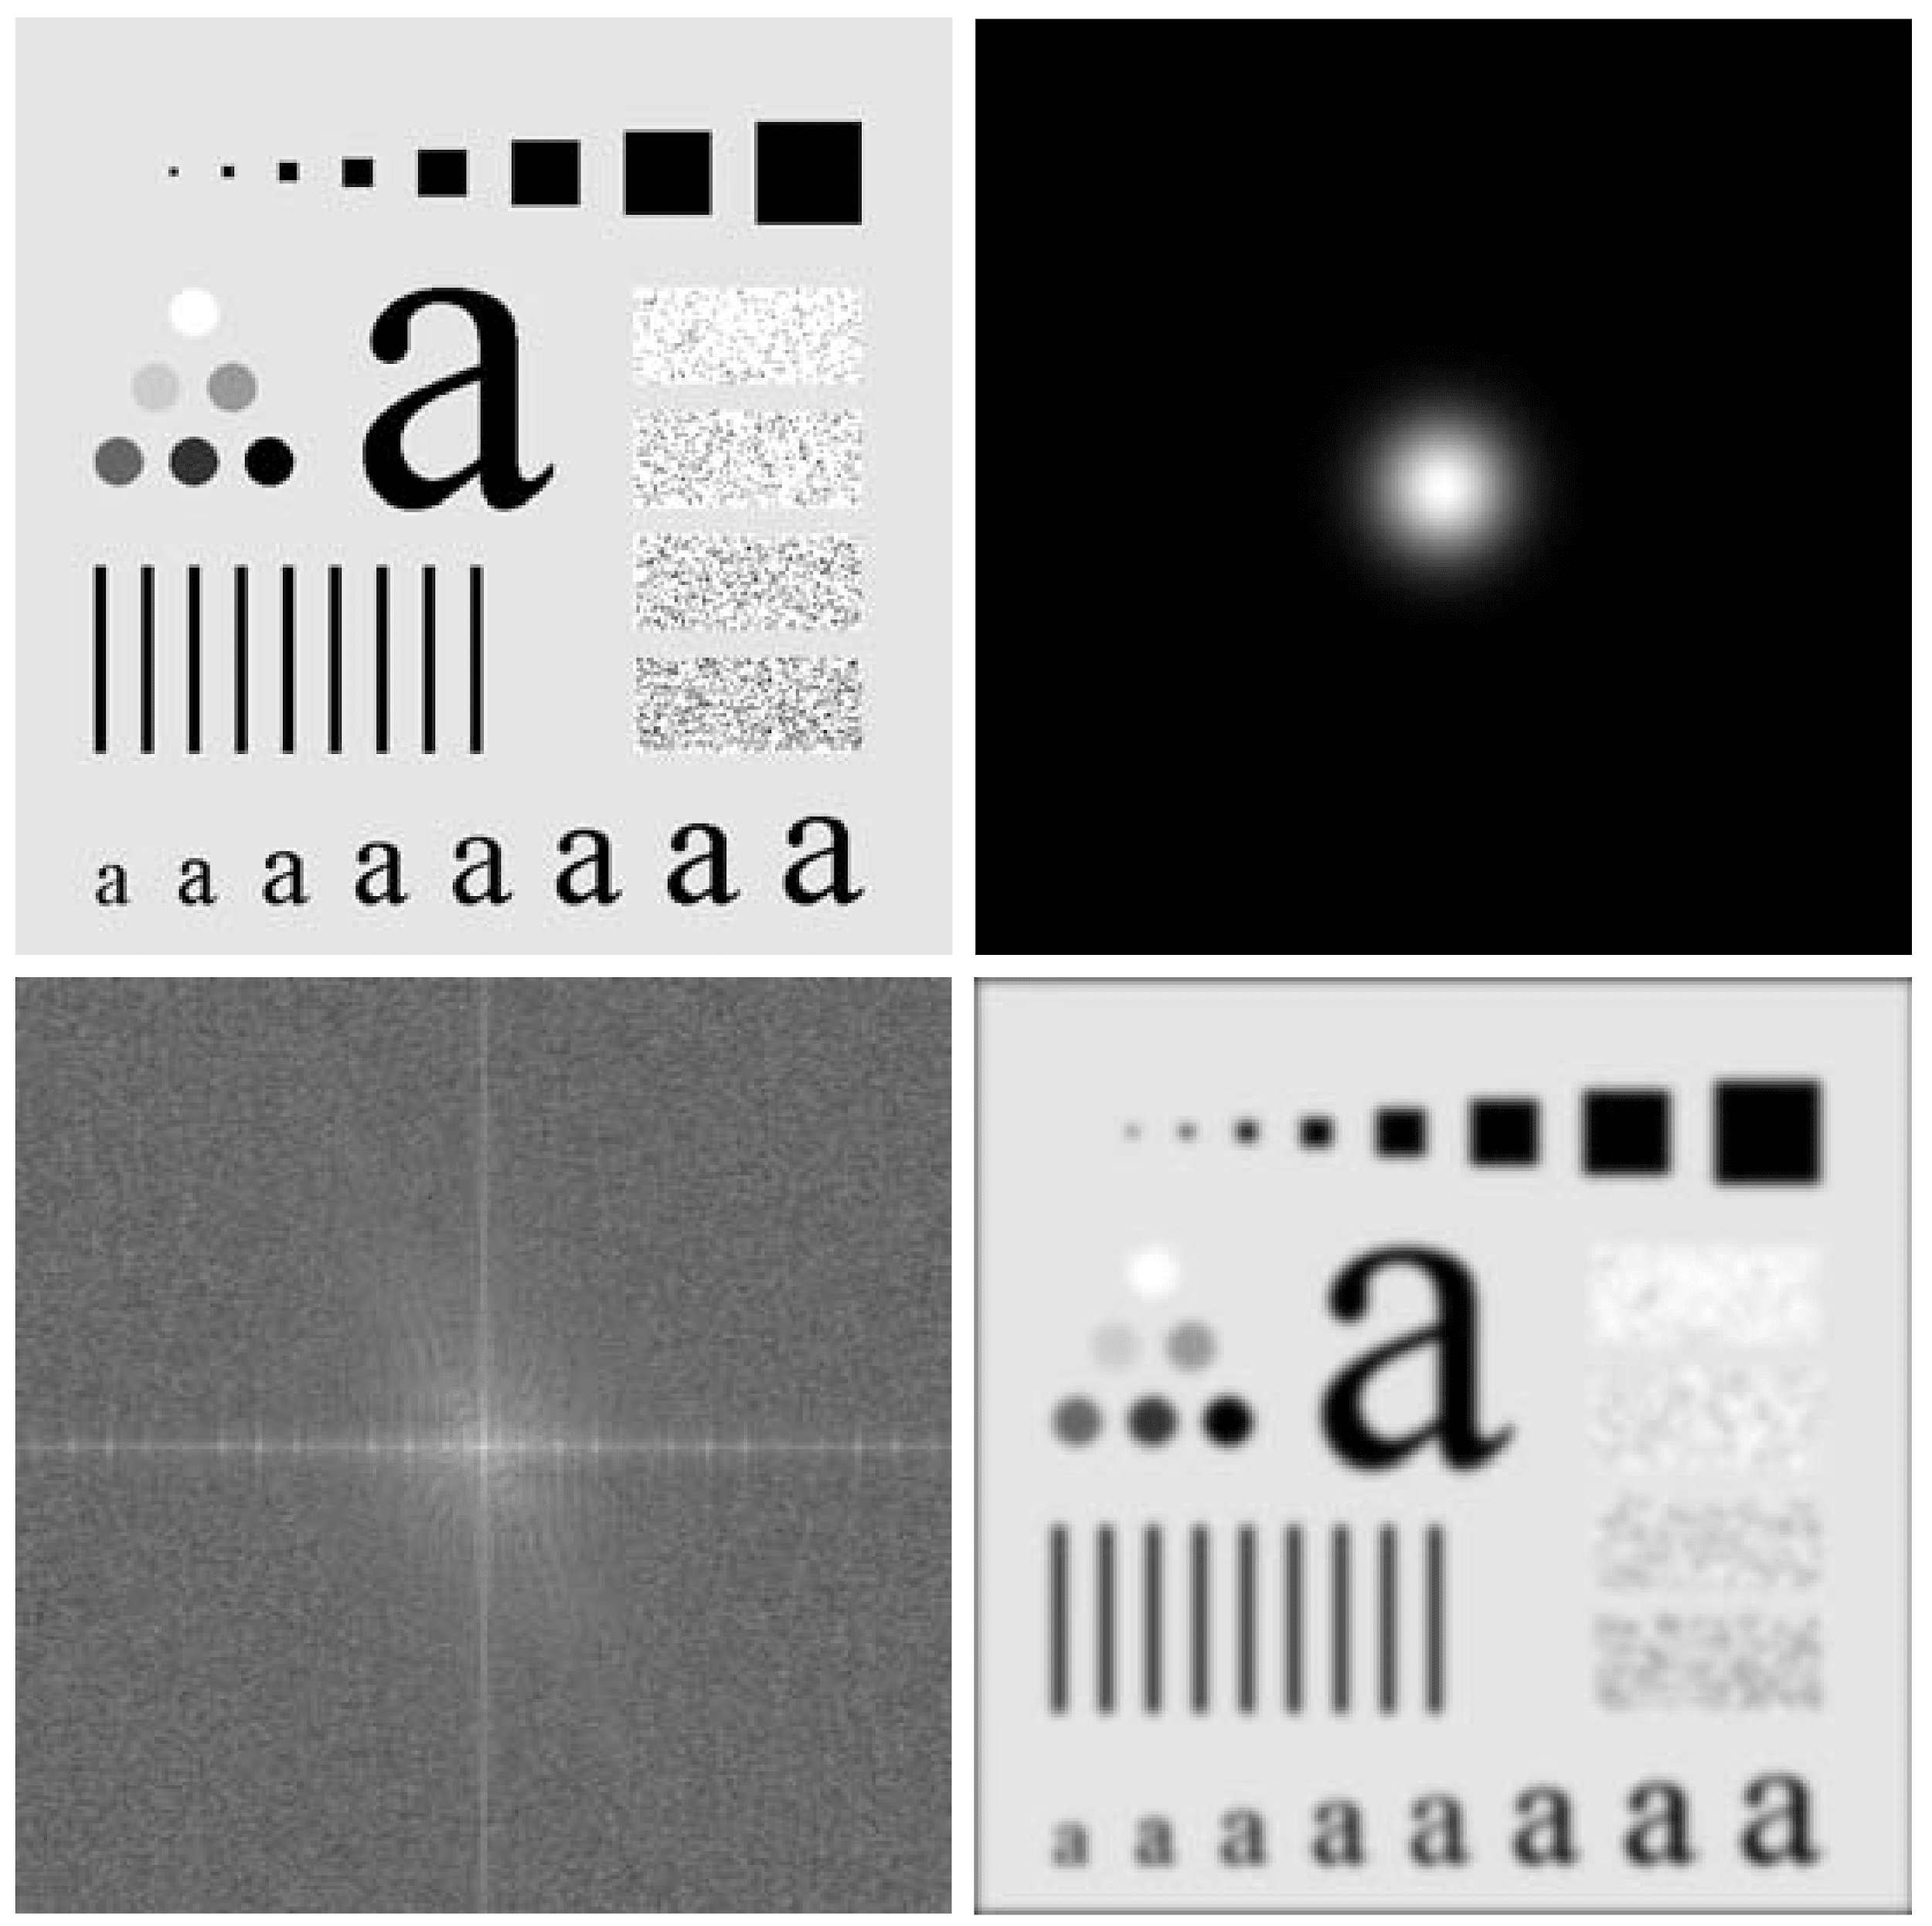
Lowpass Filtering Examples (cont…)
Original image
Gaussian lowpass filter
Images taken from Gonzalez & Woods, Digital Image Processing (2002)
Spectrum of original image
Processed image

Slide 26
Sharpening in the Frequency Domain
Edges and fine detail in images are associated with high frequency components
High pass filters – only pass the high frequencies, drop the low ones
High pass frequencies are precisely the reverse of low pass filters, so:
H_{hp}(u, v) = 1 – H_{lp}(u, v)

Slide 27
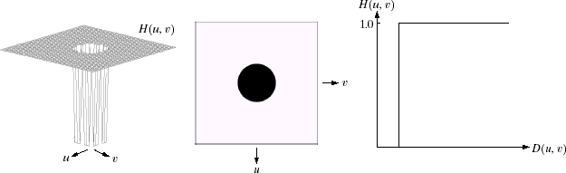
Ideal High Pass Filters
The ideal high pass filter is given as:
_{H (u, v) = ⎧⎧}0 if D(u, v) ≤ D₀
⎨⎨1 if D(u, v) > D
⎩⎩
0
where D₀ is the cut off distance as before
Images taken from Gonzalez & Woods, Digital Image Processing (2002)

Slide 28
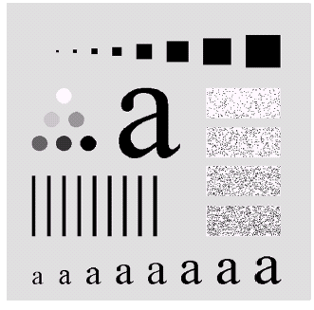
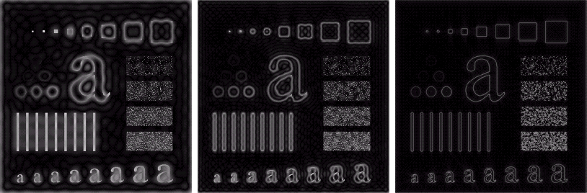
Ideal High Pass Filters (cont…)
Images taken from Gonzalez & Woods, Digital Image Processing (2002)
Results of ideal high pass filtering with D₀ = 15
Results of ideal high pass filtering with D₀ = 30
Results of ideal high pass filtering with D₀ = 80

Slide 29
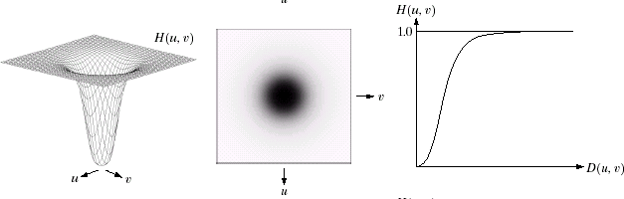
Butterworth High Pass Filters
The Butterworth high pass filter is given as:
1
H (u, v) =
1+[D / D(u, v)]^{2 n}
0
where n is the order and D₀ is the cut off distance as before
Images taken from Gonzalez & Woods, Digital Image Processing (2002)

Slide 30
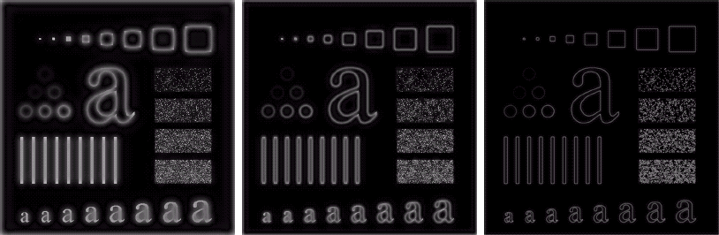
Butterworth High Pass Filters (cont…)
Images taken from Gonzalez & Woods, Digital Image Processing (2002)
Results of Butterworth high pass filtering of order 2 with
D₀ = 15
Results of Butterworth high pass filtering of order 2 with
D₀ = 80
Results of Butterworth high pass filtering of order 2 with D₀ = 30

Slide 31
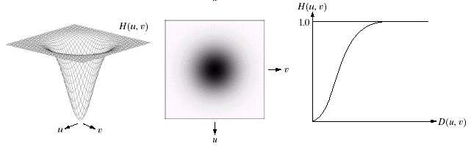
Gaussian High Pass Filters
The Gaussian high pass filter is given as:
₂ 2
_{H (u, v) = 1− e}−D (u,v)/ 2D₀
where D₀ is the cut off distance as before
Images taken from Gonzalez & Woods, Digital Image Processing (2002)

Slide 32
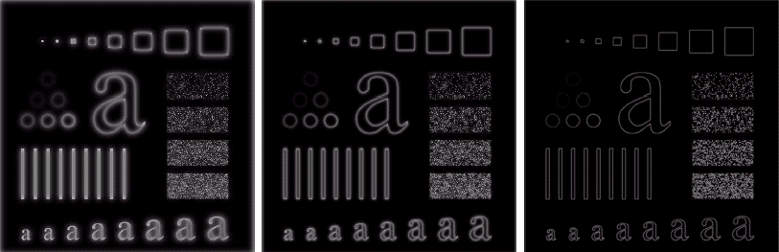
Gaussian High Pass Filters (cont…)
Images taken from Gonzalez & Woods, Digital Image Processing (2002)
Results of Gaussian high pass filtering with D₀ = 80
Results of Gaussian high pass filtering with
D₀ = 15
Results of Gaussian high pass filtering with D₀ = 30

Slide 33
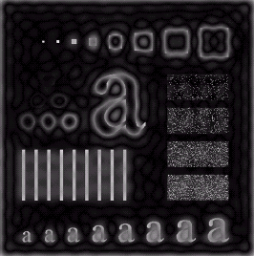
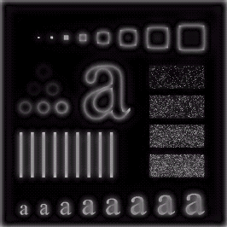
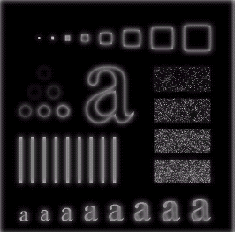
Highpass Filter Comparison
Images taken from Gonzalez & Woods, Digital Image Processing (2002)
Results of ideal high pass filtering with D₀ = 15
Results of Butterworth high pass filtering of order 2 with D₀ = 15
Results of Gaussian high pass filtering with D₀ = 15

Slide 34
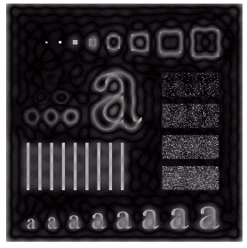
Highpass Filter Comparison
Results of ideal high pass filtering with D₀ = 15
Images taken from Gonzalez & Woods, Digital Image Processing (2002)

Slide 35
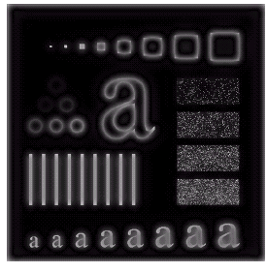
Highpass Filter Comparison
Results of Butterworth high pass filtering of order 2 with D₀ = 15
Images taken from Gonzalez & Woods, Digital Image Processing (2002)

Slide 36
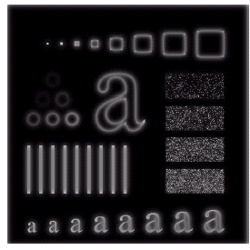
Highpass Filter Comparison
Results of Gaussian high pass filtering with D₀ = 15
Images taken from Gonzalez & Woods, Digital Image Processing (2002)

Slide 37

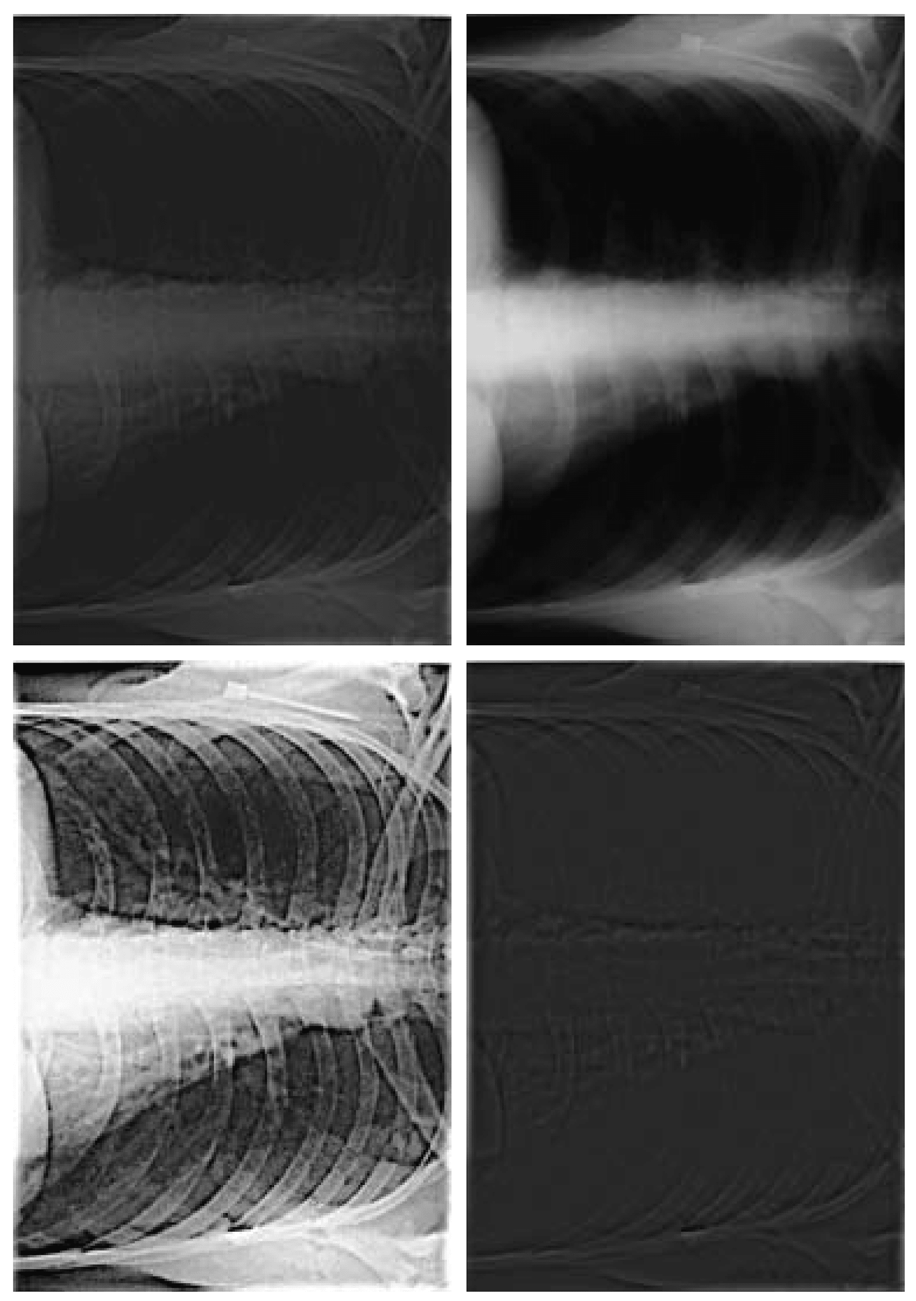
Images taken from Gonzalez & Woods, Digital Image Processing (2002)
High frequency emphasis result
Original image
Highpass Filtering Example
equalisation
Highpass filtering result
After histogram

Slide 38
Fast Fourier Transform
The reason that Fourier based techniques have become so popular is the development of the Fast Fourier Transform (FFT) algorithm
Allows the Fourier transform to be carried out in a reasonable amount of time
Reduces the amount of time required to perform a Fourier transform by a factor of 100 – 600 times!

Slide 39
Frequency Domain Filtering & Spatial Domain Filtering
Similar jobs can be done in the spatial and frequency domains
Filtering in the spatial domain can be easier to understand
Filtering in the frequency domain can be much faster – especially for large images

Slide 40
Homomorphic filtering is a generalized technique for signal and image processing, involving a nonlinear mapping to a different domain in which linear filter techniques are applied, followed by mapping back to the original domain.
Homomorphic filtering is sometimes used for image enhancement.
It simultaneously normalizes the brightness across an image and increases contrast.
Here homomorphic filtering is used to remove multiplicative noise.

Slide 41
To make the illumination of an image more even, the high-frequency components are increased and low-frequency components are decreased
Because the high-frequency components are assumed to represent mostly the reflectance in the scene whereas the low-frequency components are assumed to represent mostly the illumination in the scene.
That is, high-pass filtering is used to suppress low frequencies and amplify high frequencies

Slide 42
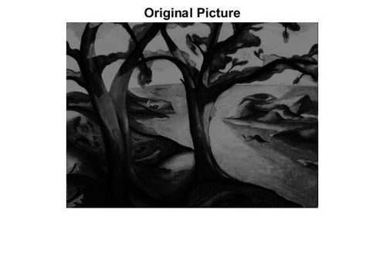
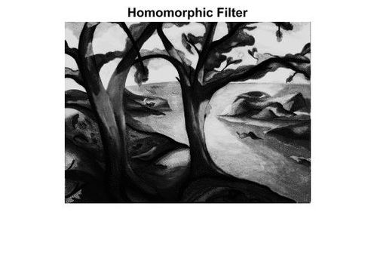

Slide 43
Thank You

